Slide 1
Human Anatomy Trivia Game
Yasmin Lynch ○ Rachel Sykes
HMI 7540 ○ Spring 2019
Notes:
Brief, 5 minute presentation

Slide 2

What Is It?
Circulatory
Digestive
Endocrine
Immune
Integumentary
Lymphatic
Muscular
Nervous
Reproductive
Respiratory
Muscular
Urinary
Notes:
Trivia Game
Target Demographic - medical students

Slide 3
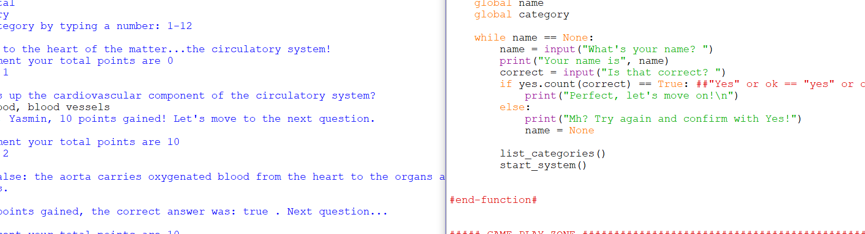

The Code
Notes:
Define Functions - commands to verify in/correct answers, tally and document the score after each question
Input - user’s name, anatomy category selections, answers
If/Elif/Else - selections for the anatomy game
Outside Research - code structure for the trivia questions/answers

Slide 4

Known Issues
Name-Stuck
Round 2 Repetition
Notes:
Name-Stuck
Issue: while loop with break
If the user inputs a name, but then answers with “no”, the user is not given the opportunity to type his/her name again.
Round 2 Repetition
Issue: no idea!
Once the user finishes the second round of questions, the program does not ask the user to select another category. Instead, the second round/category repeats. Once the second category repeats, the game ends.

Slide 5

More Time?
Category Return
Final Score/Grade
Mid-Game Escape
Notes:
Category Return
Return the list of categories after every round to make it easier for the user to make another selection.
Is there a way to remove each category from the list as the user moves through each round?
Final Score/Grade
At the end of the game, calculate the total points earned from each category and assign a letter grade or percentage with a note of encouragement.
EX:
You scored 80% in the lymphatic system - great job!
You scored 20% in the muscular system - you should study some more.
Mid-Game Escape
If the user wants to quit/exit the round or game, a kill code can be inputted with a final score.

